Slide 1


Welcome!

Slide 2
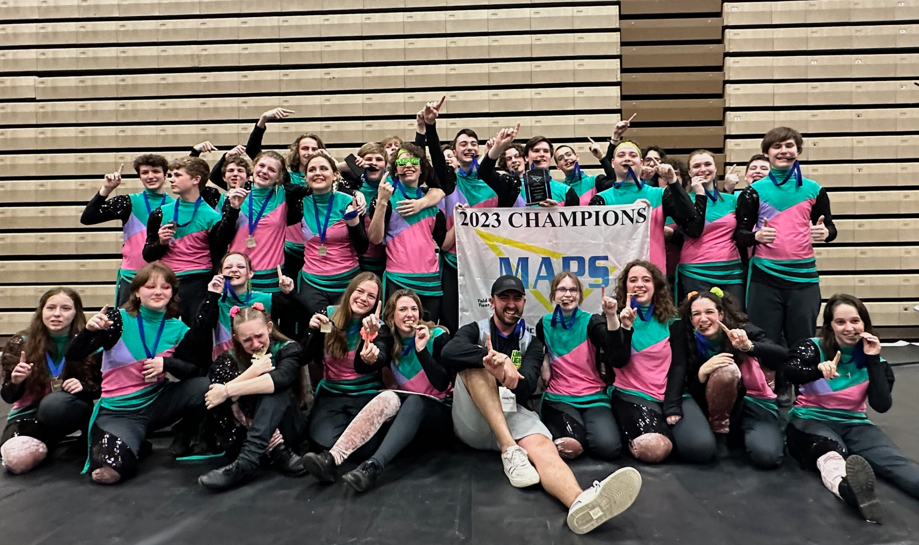

Slide 3

THANK YOU TO OUR SPONSORS…

Slide 4
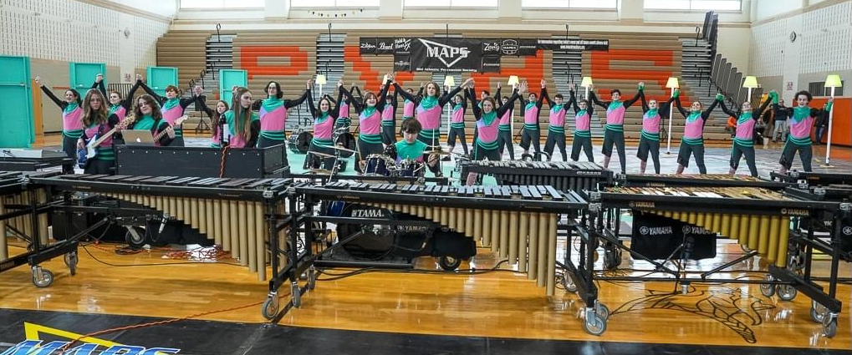

Slide 5
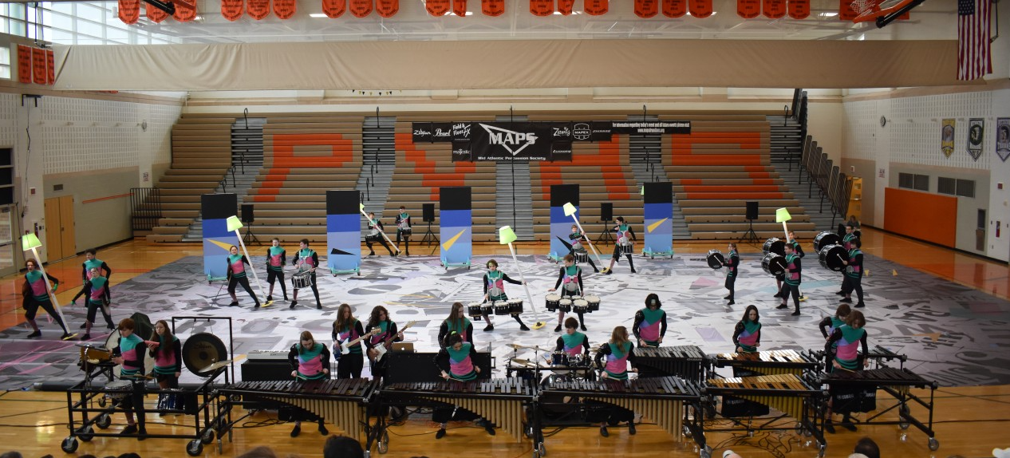

Slide 6

THANK YOU TO OUR SPONSORS…

Slide 7
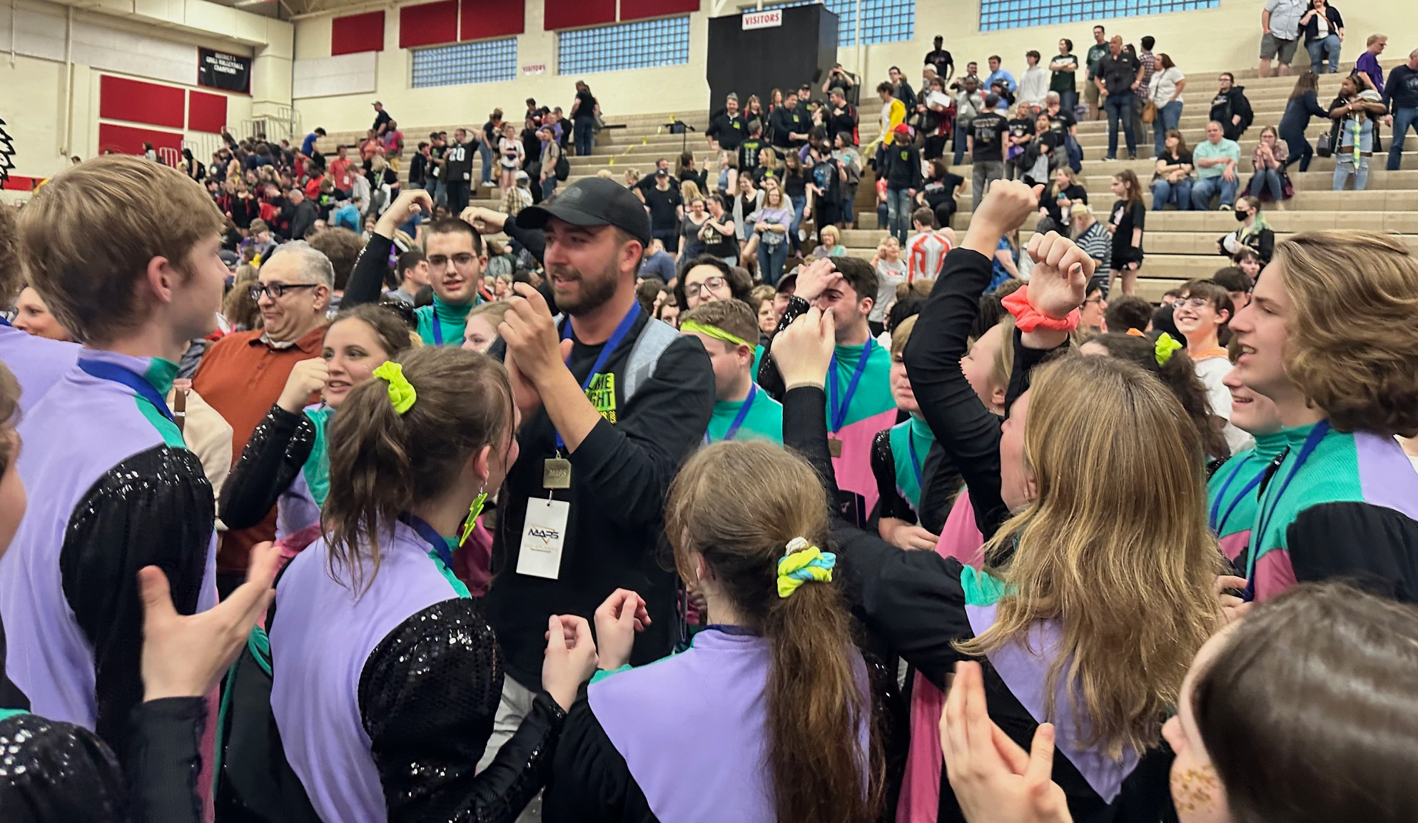

Slide 8

THANK YOU TO OUR SPONSORS…

Slide 9
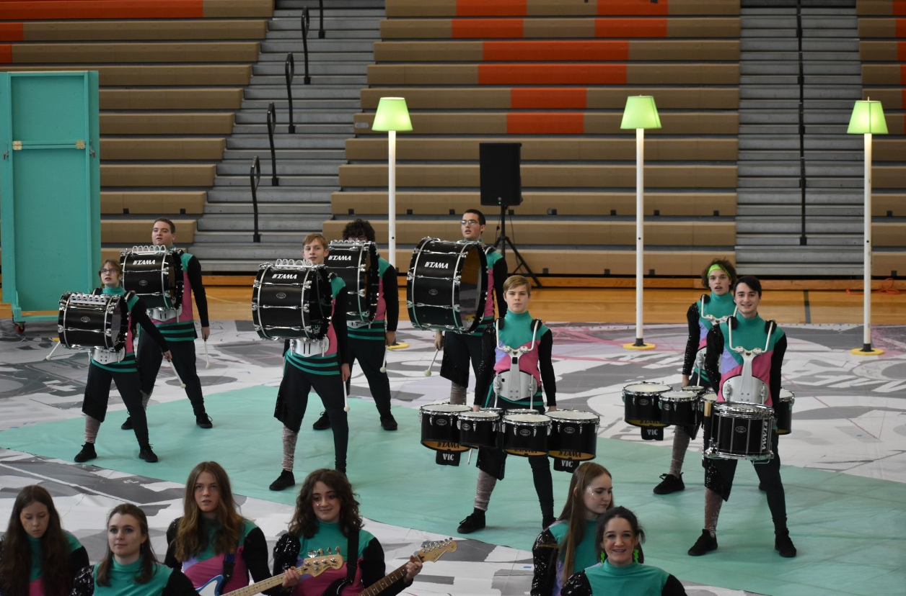

Slide 10

THANK YOU TO OUR SPONSORS…

Slide 11
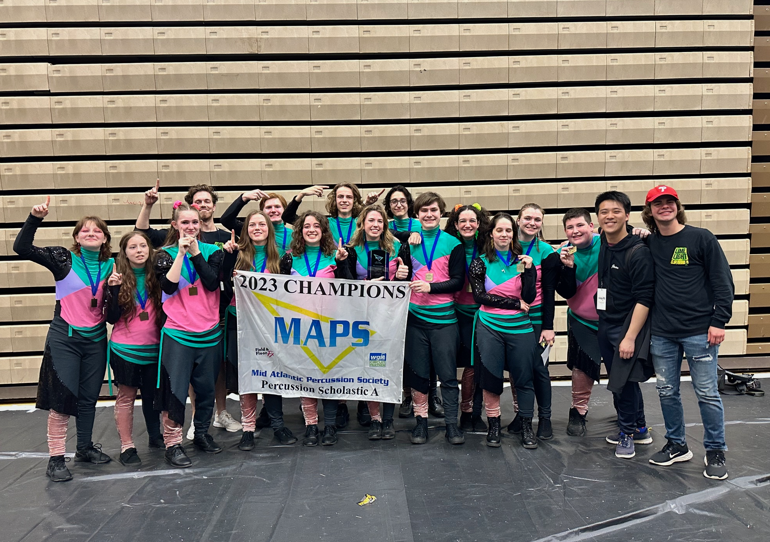

Slide 12

THANK YOU TO OUR SPONSORS…

Slide 13
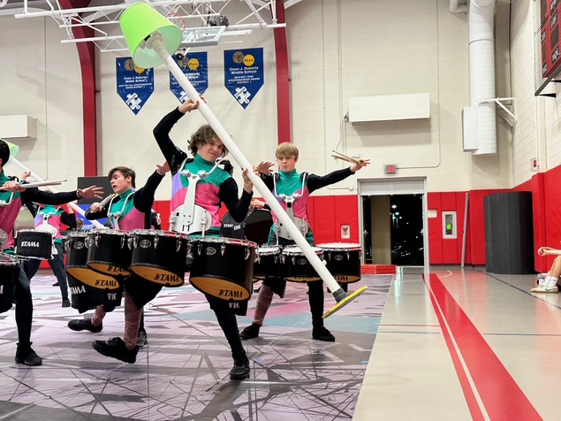

Slide 14

THANK YOU TO OUR SPONSORS…

Slide 15
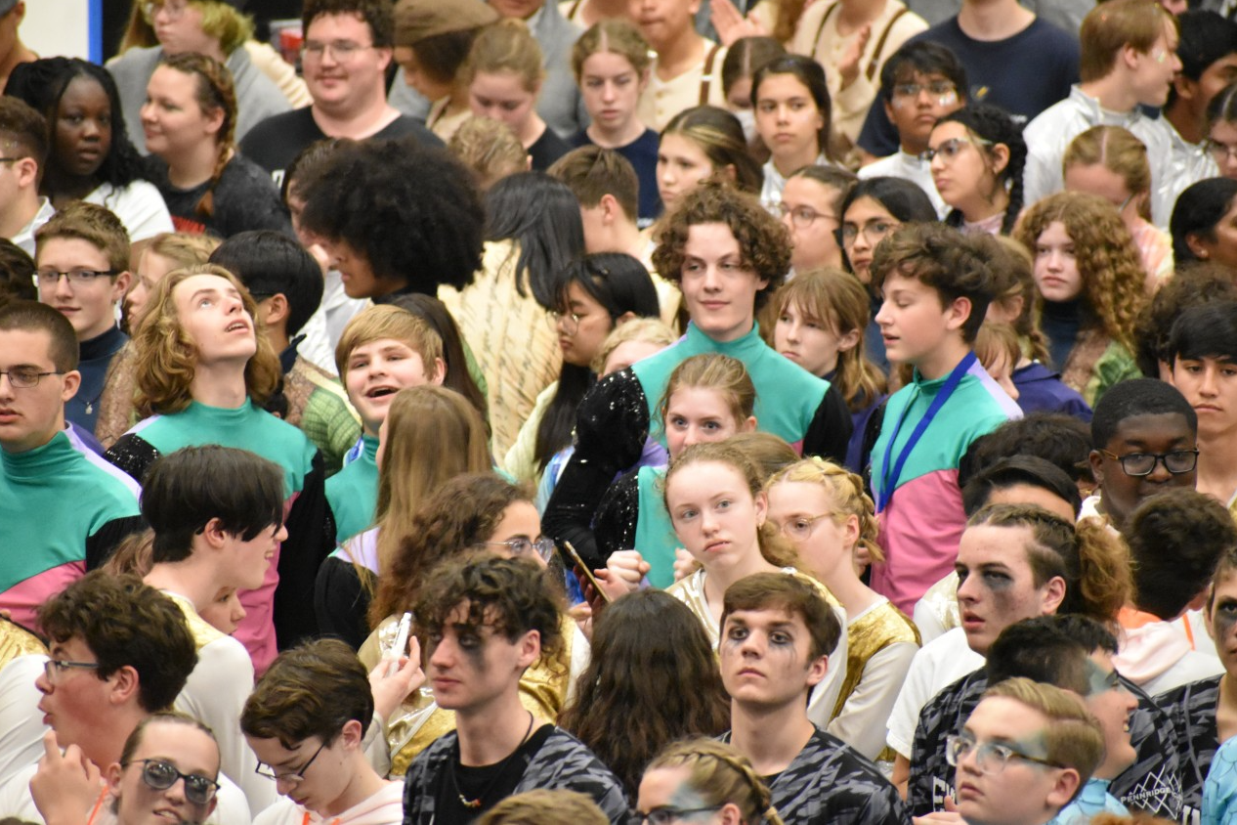

Slide 16
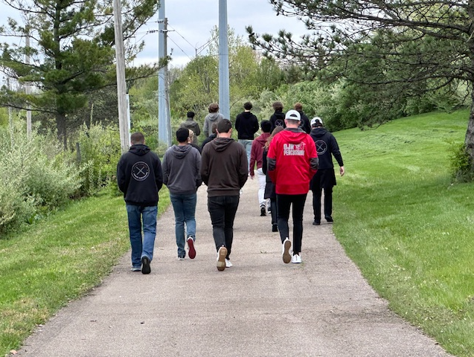

Slide 17

THANK YOU TO OUR SPONSORS…

Slide 18
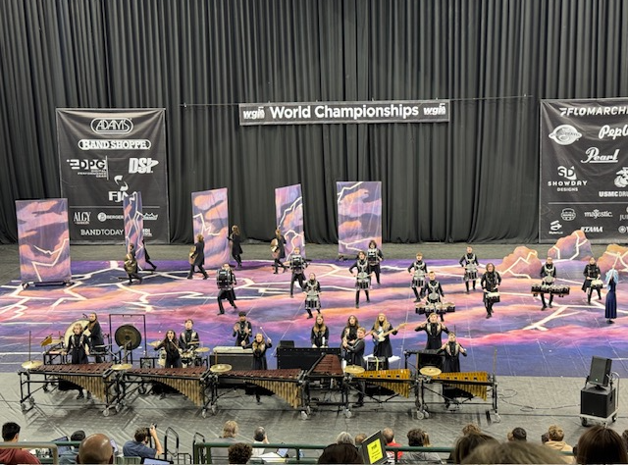

Slide 19

THANK YOU TO OUR SPONSORS…

Slide 20
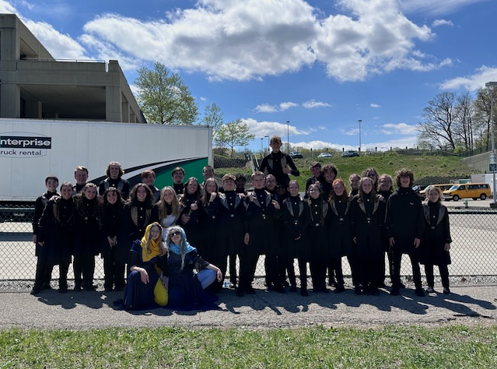

Slide 21
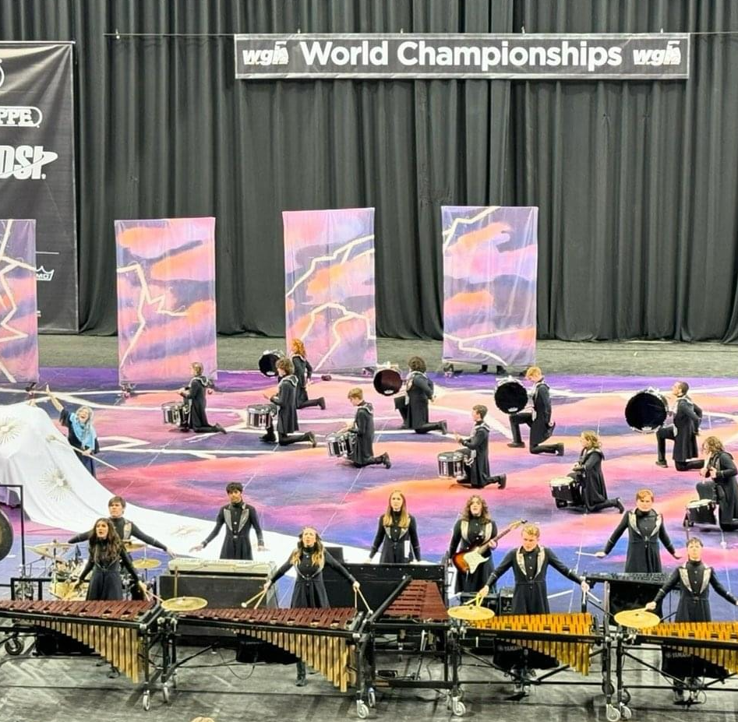

Slide 22

THANK YOU TO OUR SPONSORS…

Slide 23
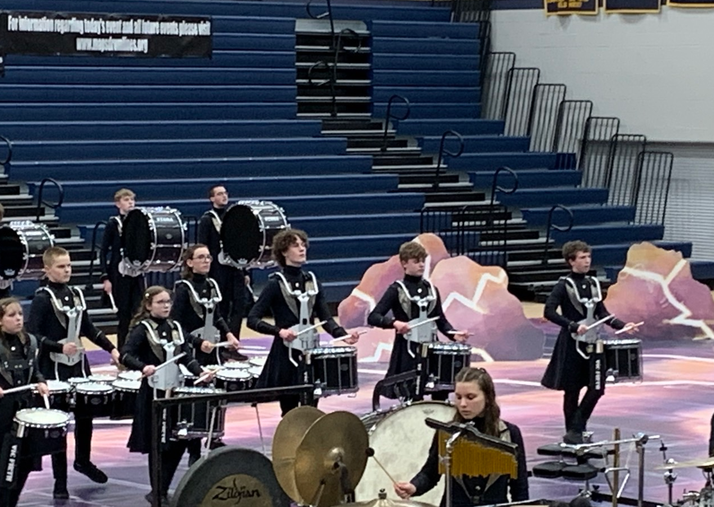

Slide 24

THANK YOU TO OUR SPONSORS…

Slide 25
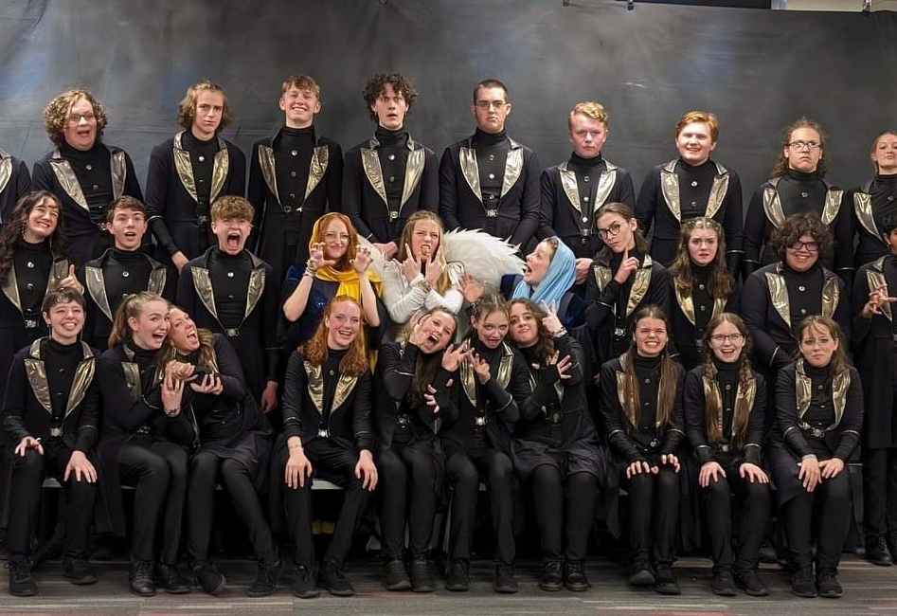

Slide 26
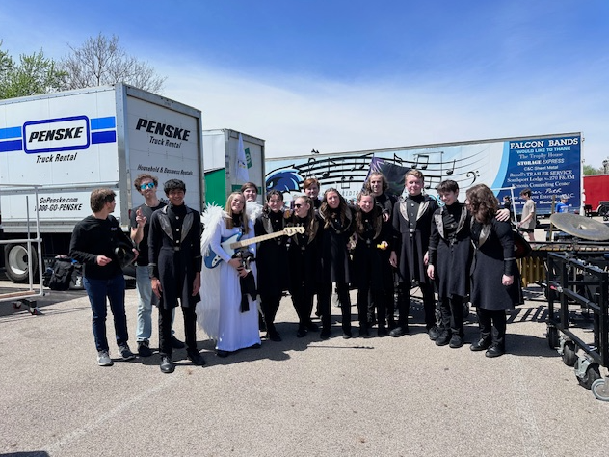

Slide 27

THANK YOU TO OUR SPONSORS…

Slide 28
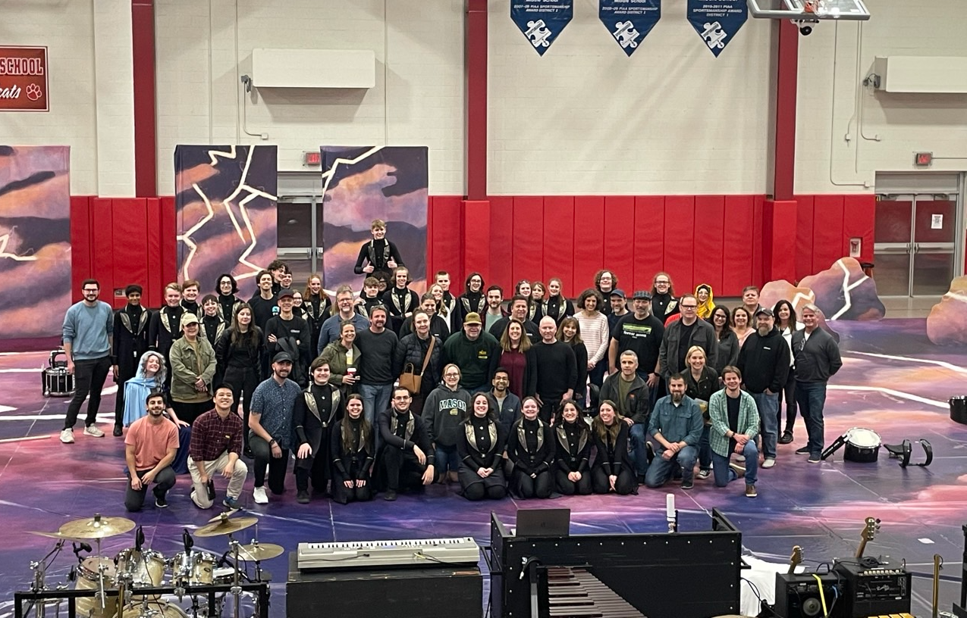

Slide 29
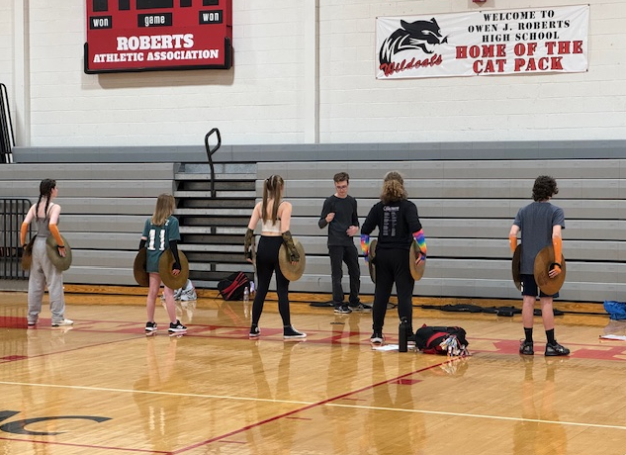

Slide 30

THANK YOU TO OUR SPONSORS…

Slide 31
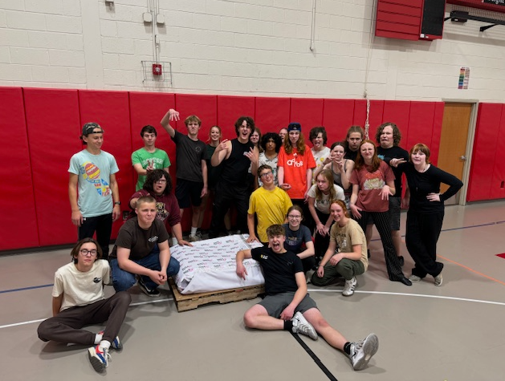

Slide 32
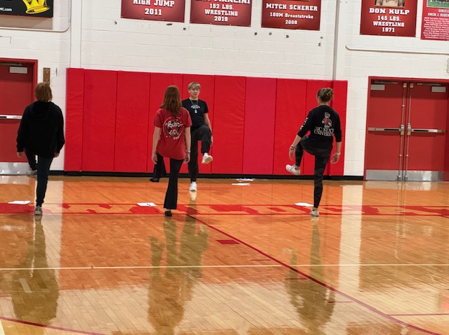

Slide 33


Friends and Family Night
Friday, February 14 / OJR MS Gym
Doors open at 8:00 PM
Show starts at 8:30 PM
Admission is Free! Donations Appreciated!
Soak
It UP!

Slide 34

THANK YOU FOR YOUR SUPPORT!

